Slide 1
Converting Facebook Members to Web Customers
Steve Newman
May 9, 2020
Notes:
This template can be used as a starter file for presenting training materials in a group setting.
Sections
Sections can help to organize your slides or facilitate collaboration between multiple authors. On the Home tab under Slides, click Section, and then click Add Section.
Notes
Use the Notes pane for delivery notes or to provide additional details for the audience. You can see these notes in Presenter View during your presentation.
Keep in mind the font size (important for accessibility, visibility, videotaping, and online production)
Coordinated colors
Pay particular attention to the graphs, charts, and text boxes.
Consider that attendees will print in black and white or grayscale. Run a test print to make sure your colors work when printed in pure black and white and grayscale.
Graphics, tables, and graphs
Keep it simple: If possible, use consistent, non-distracting styles and colors.
Label all graphs and tables.

Slide 2
Do you want to know what are the most important variables for converting Facebook members to buying customers?
Notes:
Give a brief overview of the presentation. Describe the major focus of the presentation and why it is important.
Introduce each of the major topics.
To provide a road map for the audience, you can repeat this Overview slide throughout the presentation, highlighting the particular topic you will discuss next.

Slide 3

Applying supervised learning classification models to historical data is a proven method of detecting how marketing efforts can influence a customer to buy a product.
Notes:
This is another option for an overview using transitions to advance through several slides.

Slide 4
In this study of over 1000 Facebook members, 11 targeting variables were identified as influencing purchasing behavior.
Some examples include: Dollars spent on ads, age and gender of customer, and interests expressed by FB member.

Slide 5

After trying 5 model types, the Decision Tree with Grid Search produced the most reliable result.

Slide 6
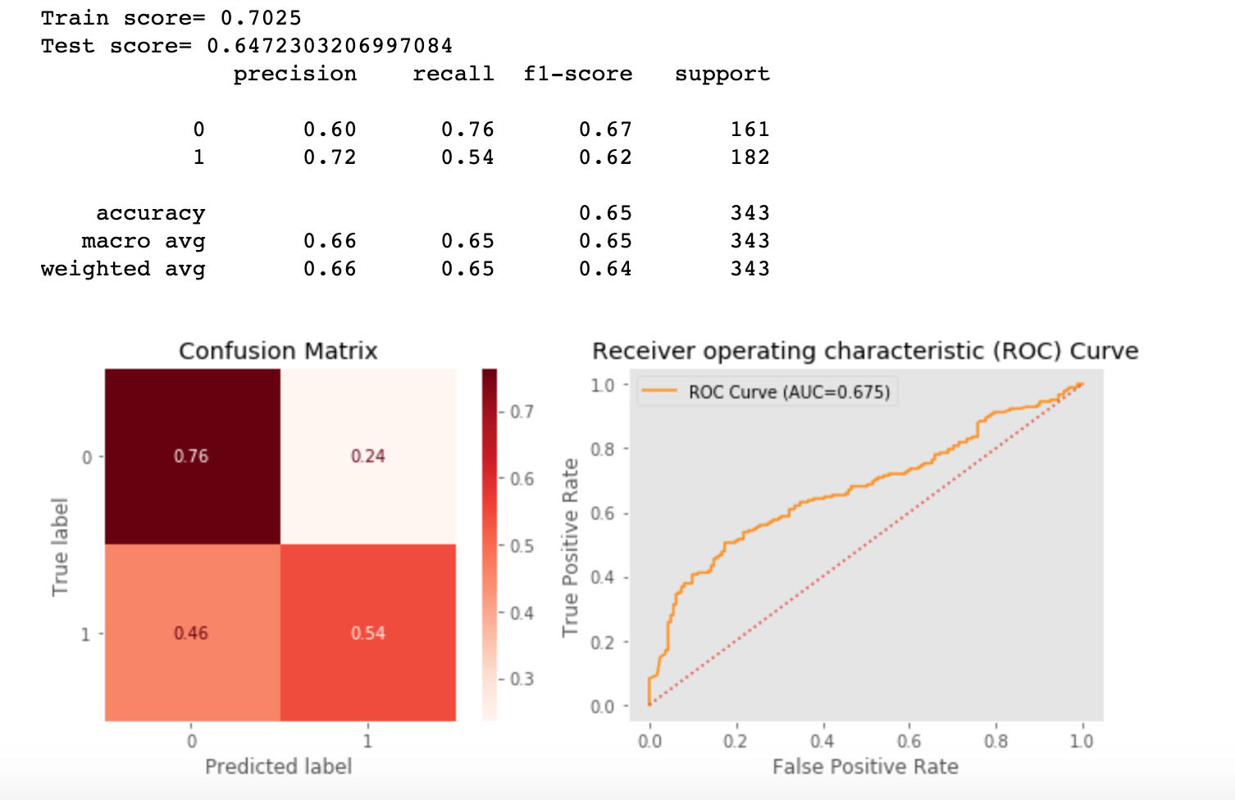
Notes:
This is another option for an overview using transitions to advance through several slides.

Slide 7
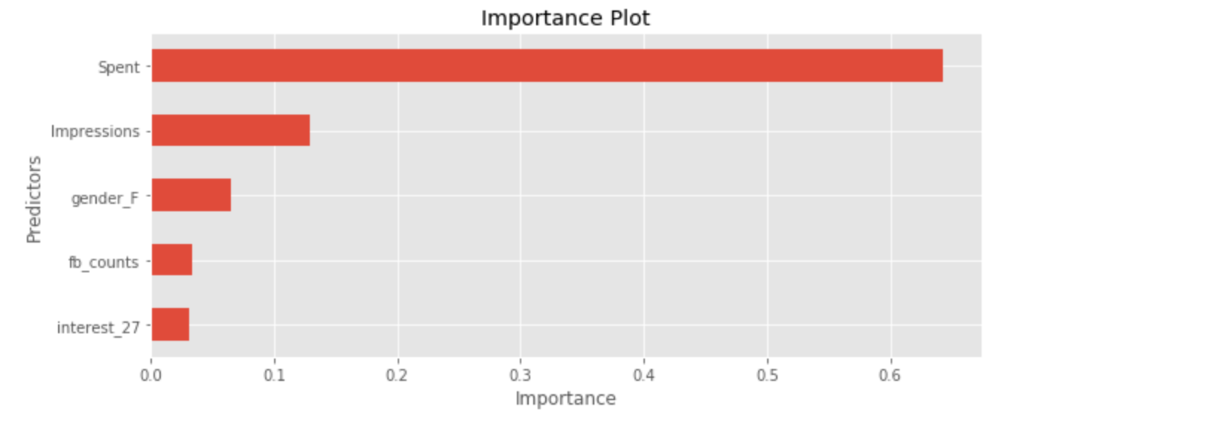
Predictors of Importance
Notes:
This is another option for an overview slide.

Slide 8
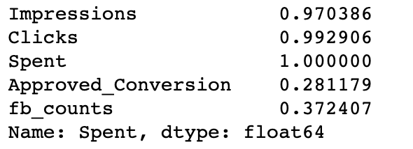
High Correlation in 3 Categories

Slide 9
Future Work
Work with larger data sets.
Look at trends across seasonal time periods.
Translate Interest Codes
Notes:
What will the audience be able to do after this training is complete? Briefly describe each objective and how the audience will benefit from this presentation.

Slide 10
Thank you!
Any Questions?
Notes:
Use a section header for each of the topics, so there is a clear transition to the audience.

